Slide 1
1
Food Distribution Program
WBSCM Assign Multi-Role Users
Texas Department of Agriculture
USDA Division

Slide 2
2
Why WBSCM?
The FDP Module in TX-UNPS does not have an upgrade.
In 2010, USDA launched the Web Based Supply Chain Management System (WBSCM) specifically to support FDP.
USDA owns and regularly upgrades WBSCM, making it the best solution to serve RAs in Texas now and in the future.

Slide 3
Acknowledgement Statement
You understand and acknowledge that:
The training you are about to take does not cover the entire scope of the program; and that
You are responsible for knowing and understanding all handbooks, manuals, alerts, notices, and guidance, as well as any other forms of communication that provide further guidance, clarification, or instruction on operating the program.

Slide 4
4
WBSCM Transition Page QR Code:
Scan QR Code to visit the Food Distribution Program WBSCM Transition website

Slide 5
5
01
Course Introduction
Course Outline and Objectives

Slide 6
6
Introduction
01
Course Overview and Objectives
02
Manage Users
Navigate portal pathways to manage user details
03
Assign User Role(s)
Assign user roles based on appropriate job function
WBSCM Entitlement
Course Outline

Slide 7
7
Course Objectives and Outcomes
By the end of this course, participants will be able to:
Understand how User Administrators assign multiple security roles to the same person in WBSCM.

Slide 8
8
WBSCM RA User Roles
RA User Roles
1) User Admin-RA | Can create new users, update contact information, update assigned roles for users within their RA organization, and deactivate user accounts that are no longer needed.
2) Org Admin-RA | Maintains organization data and view users assigned to its organization.
3) Order Manager-RA | Role tasks include, but not limited to, creating requisitions, running entitlement/bonus reports, etc.
4) View Only-RA | ﻿Has access to order management, material pricing, and entitlement reports.

Slide 9
9
WHEN
EXAMPLES
Use this procedure for organizations who have one user fulfilling multiple roles in WBSCM.
1. The Food Service Director is the only staff
member and needs to see and do everything.
2. The Food Service Director appoints staff to perform separate functions
FSD: User Admin to manage staff
Staff #1: Order Manager to place requests & Org Admin to maintain organization data

Slide 10
10
02
Existing User:
Assign Multiple Roles
Portal Pathway

Slide 11
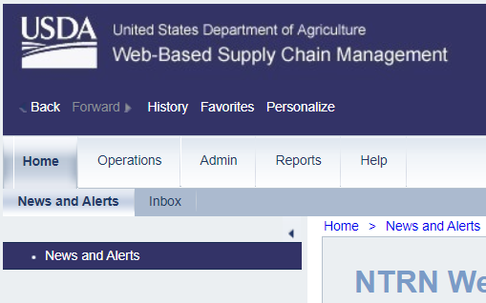
11
Assign Multiple Roles
To assign a user multiple roles, follow the steps on each slide.
Click on “Admin” tab
Notes:
The next slides will review portal pathways and directions to assign a user roles in WBSCM.

Slide 12
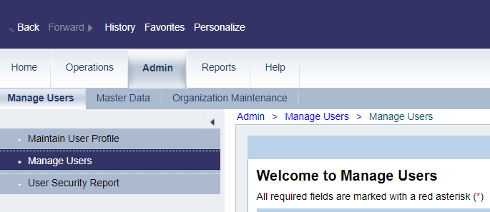
12
Assign Multiple Roles
Click on “Manage Users”

Slide 13
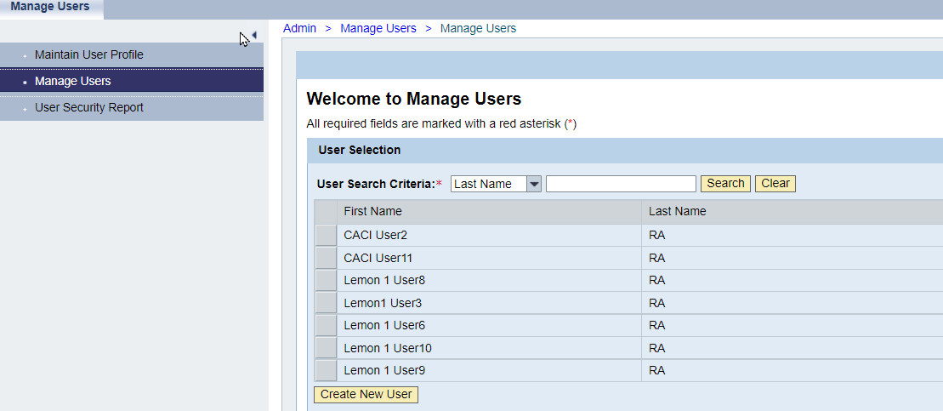
13
Assign Multiple Roles
User Search Panel
All existing users listed here

Slide 14
14
Assign Multiple Roles
Click on an existing User Search Criteria section in to add additional roles.

Slide 15
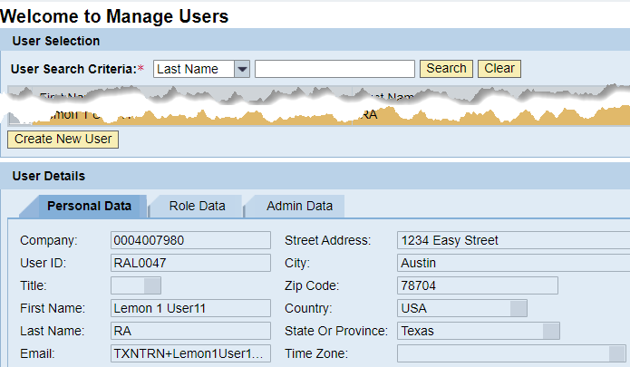
15
Assign Multiple Roles
“User Details” panel will appear below “User Selection” panel.

Slide 16
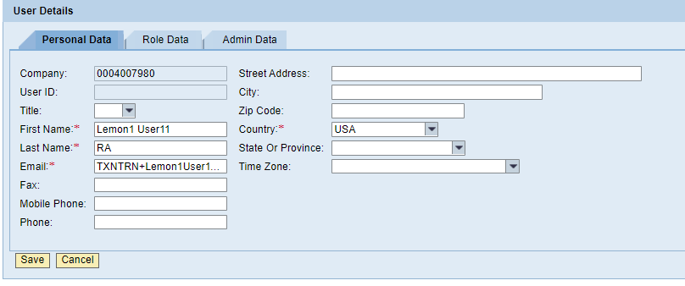
16
Assign Multiple Roles
Click on the “Role Data” tab to assign user role(s).

Slide 17
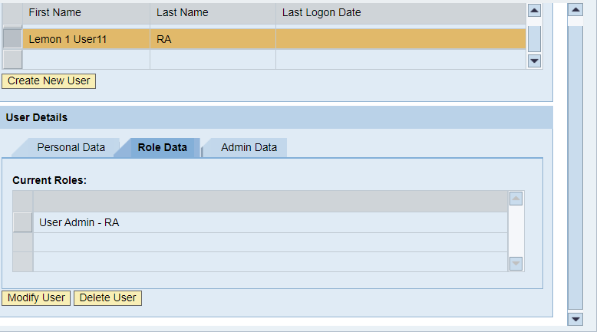
17
Assign Multiple Roles
Roles currently assigned to user listed under “Current Roles”

Slide 18
18
Assign Multiple Roles
Click on “Modify User” to add more user roles to account.

Slide 19
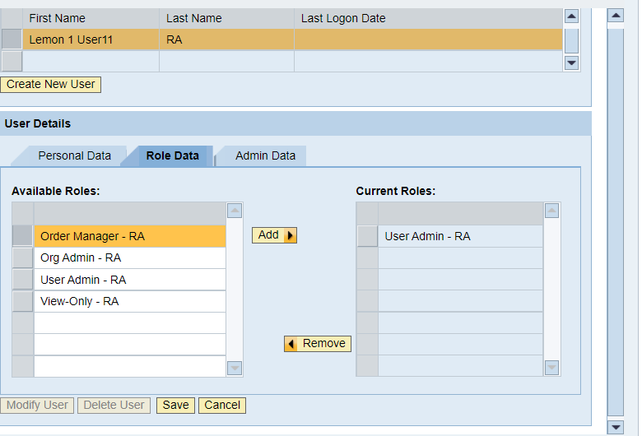
19
Assign Multiple Roles
All available roles for user will appear.

Slide 20
20
Assign Multiple Roles
Click on “Order Manager” to assign role.

Slide 21
21
Assign Multiple Roles
Click the Add button.

Slide 22
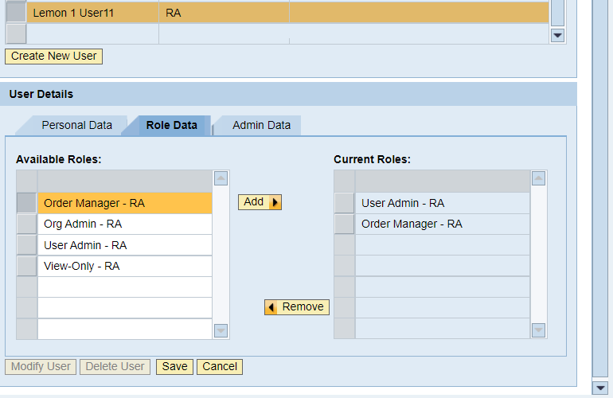
22
Assign Multiple Roles
New role appears in “Current Roles” column.

Slide 23
23
Assign Multiple Roles
Click “Save” to complete adding a new role(s).

Slide 24
24
Assign Multiple Roles
All roles currently assigned to new user will appear in the “Current Roles” column.

Slide 25
25
Assign Multiple Roles
Assign New User Role Complete!
Repeat process to add additional roles as needed.

Slide 26
26
Questions?
Notes:
Collect questions in all training settings to create FAQ for RA105

Slide 27
27

Slide 28
28
Contact Us
https://squaremeals.org/Programs/FDPWBSCMTransitionProject.aspx
Diana Chavarria
CN Technical Support
Diana.Chavarria@esc15.net
325.658.6571

